Slide 1
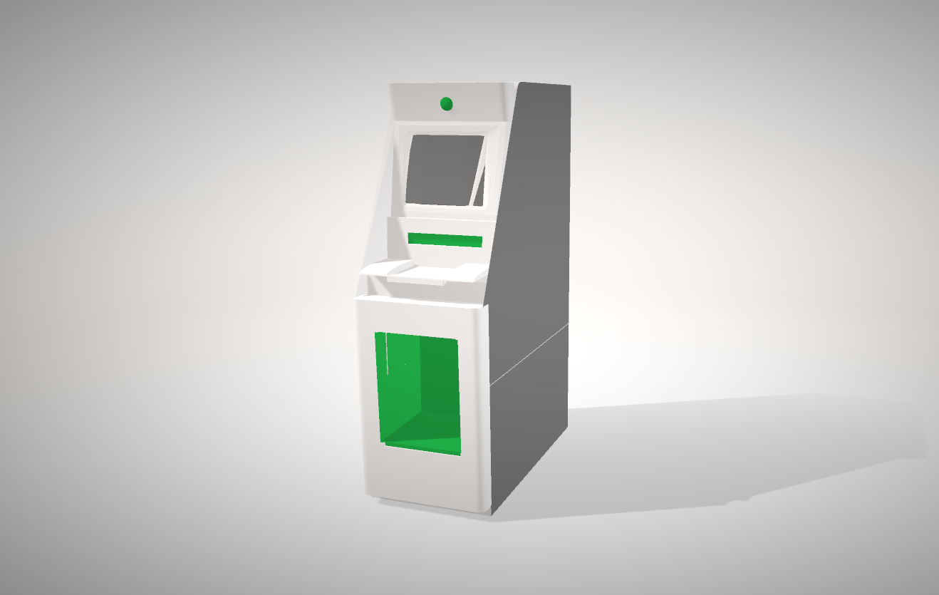
AirPrint 3D
Camera
Display
Cash
Keys
3D Printer

